Slide 1

Presentation on: 5G Technology
By,
Piyush Warke
TE Computer Engineering
Roll No: 61
Guided By,
Prof. Atul Chaudhari
MET’s BKC Institute of Engineering, Nashik
Notes:
*
*

Slide 2
Index
Introduction
Architecture and Challenges
Advantages and Disadvantages
Conclusion
References
1
5G Technology
28/4/19
Notes:
*
*

Slide 3
Introduction
What is 5G?
5G is latest generation of cellular mobile communication.
5G is abbreviation for 5th generation communication network technology.
Previously 1G, 2G, 3G and 4G are major communication technologies are developed.
5G is currently under complete development.
5G networks are digital cellular networks in which service are covered by providers is divided into small geographical areas called cells.
5G can support up to million devices per sq. km where its preceder 4G supports only 4000 devices per sq. km.
2
5G Technology
28/4/19
Notes:
*
*

Slide 4
Key Enabling Technologies
Advanced Network
mm Wave
Multi RAT (Radio Access Technology)
Massive MIMO
Advance D2D (Device to Device)
Small Cell
Full Duplex (Two way communication)
3
5G Technology
28/4/19

Slide 5
Target Performance
Spectral Efficiency : 10bps/Hz
Data rate : 1 Gb – 10 Gb peak
Connection Density : 10⁶ Devices per sq. km (Vehicles and Smart devices)
Mobility : 300-500 km/h
Latency : 5ms (end to end) – 1ms (Over the air)
6
5G Technology
28/4/19

Slide 6
What 5G offers?
Worldwide cellular phones
High connectivity
Extraordinary data capabilities
More power & features in hand held phones
Large phone memory, more dialing speed, more clarity in audio & video
Incredible transmission speed
REAL wireless world
7
5G Technology
28/4/19

Slide 7
Major Technologies of 5G
5G
mm Waves
Massive MIMO
Beam Forming
Full Duplex
Small Cell
8
5G Technology
28/4/19

Slide 8
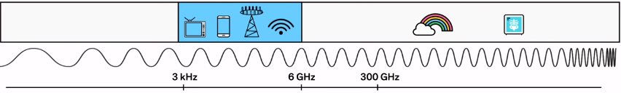
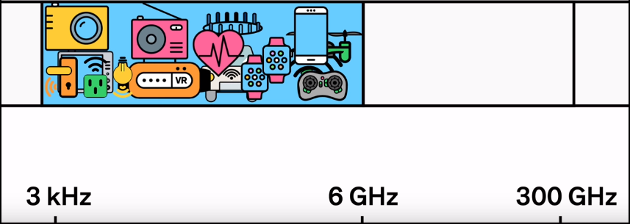
Mm Wave (Millimeter Wave)
The term mmWave refers to a specific part of the radio frequency spectrum between 24GHz and 300GHz.
Only specific amount of spectrum is used for connectivity of devices in current technologies.
New devices such as mobile phones, smart bands, radio, television, smart devices, bluetooth speakers, etc. are being added to the same frequency band.
Hence spectrum is getting crowded.
As more devices come online, connection starts getting interrupted
Services become slower as more devices are added.
9
5G Technology
28/4/19

Slide 9
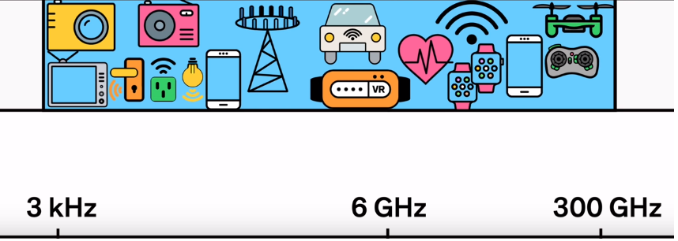
Mm Wave (Millimeter Wave)
The solution is to open up new frequency spectrum.
Broadcasting on shorter millimeter waves
30-300 GHz spectrum can be used to build whole new communication network
This section has never been used for mobile devices
Opening it up means more bandwidth for everyone.
mmWaves can not travel well through obstacles and tend to be absorbed by plants and rain.
10
5G Technology
28/4/19

Slide 10
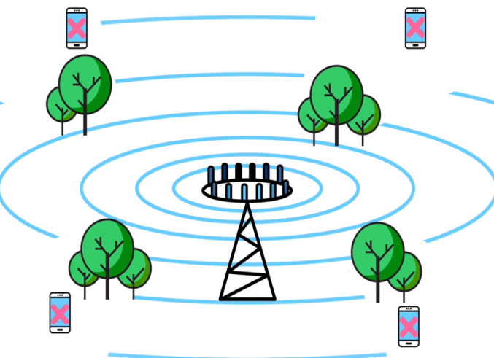
Small cell
Today’s wireless networks relay on large high powered cell towers to broadcast their signal over long distance
Higher frequency mmWaves can not penetrate obstacles
mmWaves cannot travel long distance without
interruption
Moving behind any obstacle can loose signal
11
5G Technology
28/4/19

Slide 11
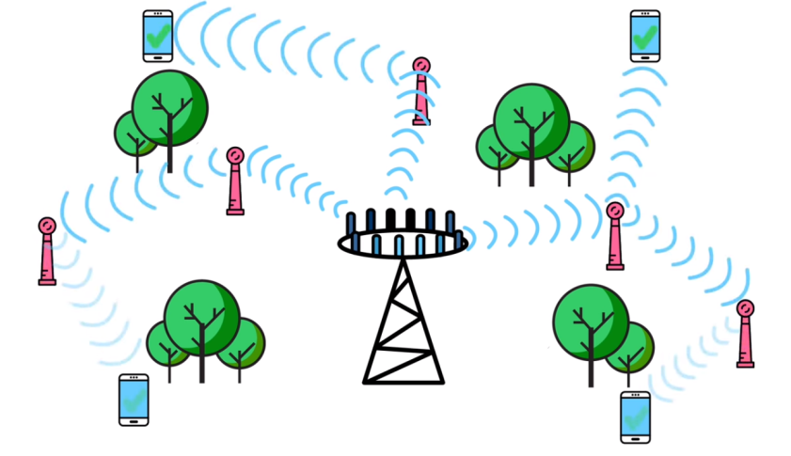
Small cell
This problem can be solved using small cell network
Using thousands of low powered mini Base stations
These base stations would be much closer
than traditional towers
Relay team formation to transmit and
repeat signals around obstacles
Specially useful in cities
Automatically switching between base stations
Interrupt-less connection
12
5G Technology
28/4/19

Slide 12
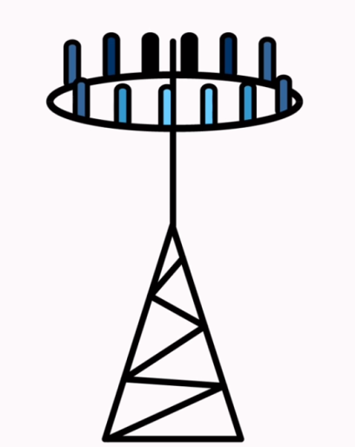
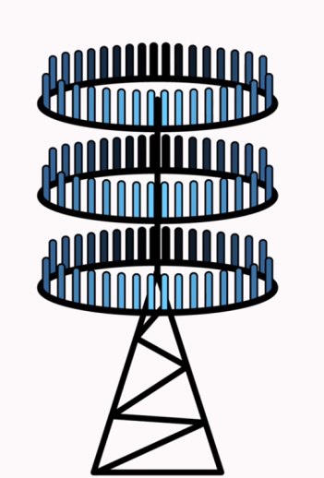
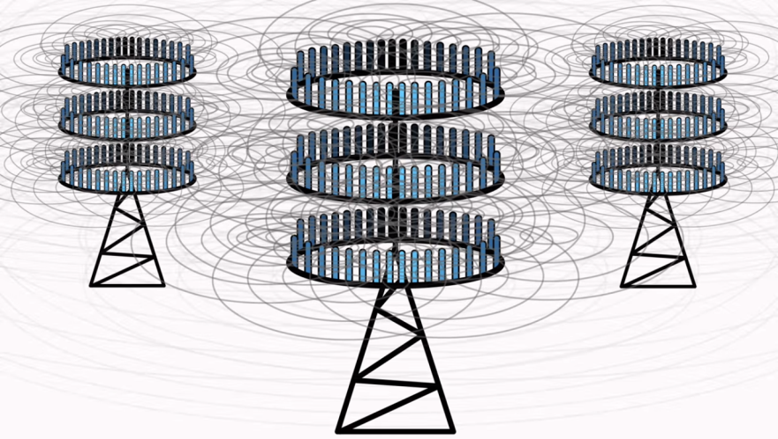
Massive MIMO
Multiple Input Multiple Output
4G base stations have about dozen ports for antennas that handle all cellular traffic
MIMO increases capacity of current network by factor of 22 or more
Cellular antennas broadcast signal in every direction at once
Crossing signals can cause interference
13
4G tower
MIMO Tower
Interference generation due to signal crossing
5G Technology
28/4/19

Slide 13
Beam Forming
Traffic signaling system for cellular signals
Broadcasting in every direction causes interference and repeitation
Base station is allowed to send focused stream of data to specific user
Precision prevents interference
Increased efficiency
Handling more incoming and outgoing data streams at once
14
5G Technology
28/4/19

Slide 14
Full Duplex
Single node communication e.g. Walkie-Talkie
Base stations’s traditional antenna can do only one job at a time Transmit or Receive
This is because of reciprocity
Tendency for radio waves to travel both backward and forward along the same frequency
If transmission and receiving is done at a time, interference occurs
15
5G Technology
28/4/19

Slide 15
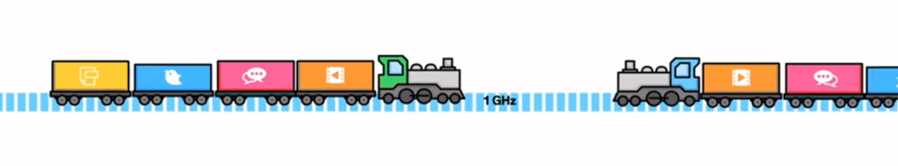
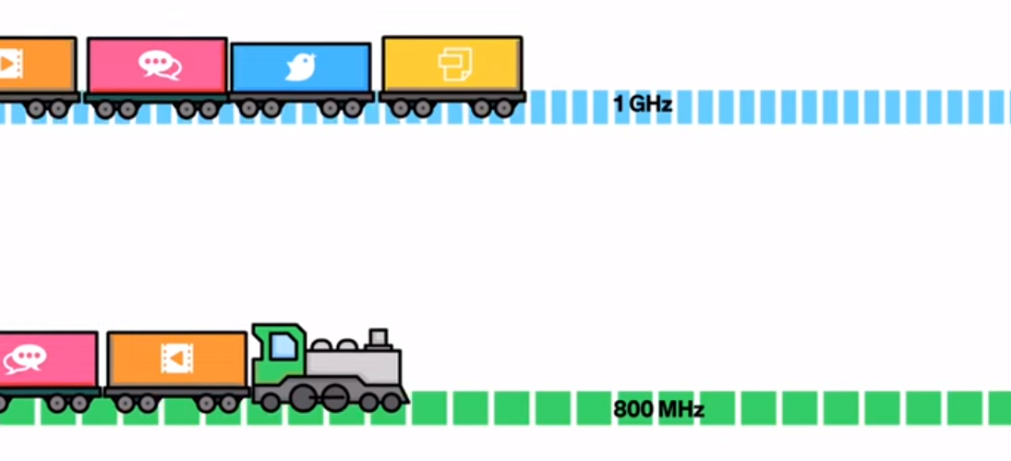
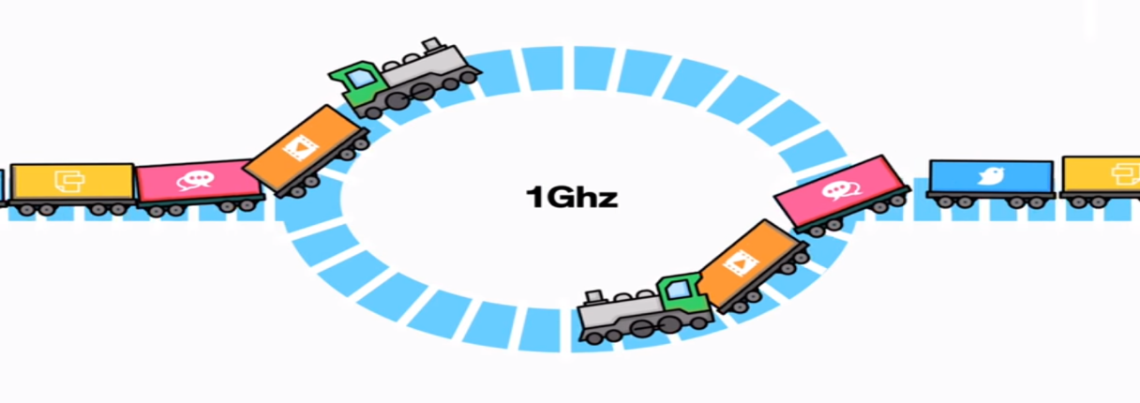
Full Duplex
Example of train as signal,
Silicon Transistor to create high speed switches to halt backward roll of these waves
16
5G Technology
28/4/19

Slide 16
Advantages
High resolution and bi-directional large bandwidth shaping.
Technology to gather all networks on one platform.
More effective and efficient.
Technology to facilitate subscriber supervision tools for the quick action.
Easily manageable with the previous generations.
Most likely, will provide a huge broadcasting data (in Gigabit), which will support more than 60,000 connections.
Technological sound to support heterogeneous services (including private network).
Possible to provide uniform, uninterrupted, and consistent connectivity across the world.
Parallel multiple services.
17
5G Technology
28/4/19

Slide 17
Disadvantages
Developing infrastructure needs high cost.
Security and privacy issue yet to be solved.
Many of the old devices would not be competent to 5G, hence, all of them need to be replaced with new one expensive deal.
Hardware replacement is required for each device.
18
5G Technology
28/4/19

Slide 18
Conclusion
5G technology is the upcoming technology and the bandwidth for this is very high and was having higher data transfer rate. However, now we are using the 3G technology efficiently and in some countries the people are using the 4G but in future we can use the 5G technology. Many big countries are investing huge amount of money on this project as it was having high demand in the future. It will altogether manufacture flexibility, limit, degree, comparability and meeting. Thus, it will satisfy the growing solicitations of rising bigdata, cloud, machine to machine, and diverse applications.
19
Seminar Title
28/4/19

Slide 19
References
[1] Asvin Gohil Charotar, University of Science and Technology. Gujarat, In- dia 5G Technology of Mobile Communication: A Survey 978-1-4799-0317- 7/13/31.002013 IEEE
[2] J.S.Bae, et al., Architechture and perfornance evaluation of mm wavebased on 5G
Mobile communication system, IEEE ICTC 2014, pp. 847-851, 2014.,
[3] T. Marzetta, E. G. Larsson, H. Yang and H. Q. Ngo, Fundamentals of Massive
MIMO, Cambridge University Press, 2016.
[4] Full Duplex Communications in 5G Small Cells Nurul H. Mahmood, Marta G. Sarret, Gilberto Berardinelli and Preben Mogensen IEEE 11th International Symposium on Wireless Communications Systems (ISWCS). Aalborg University, Denmark.
[5] Internet Resource, Ericsson: http://www.ericsson.com/openarticle/mwc-
connected-devices
20
Seminar Title
28/4/19

Slide 20
Thank You
21
28/4/19

